Slide 1

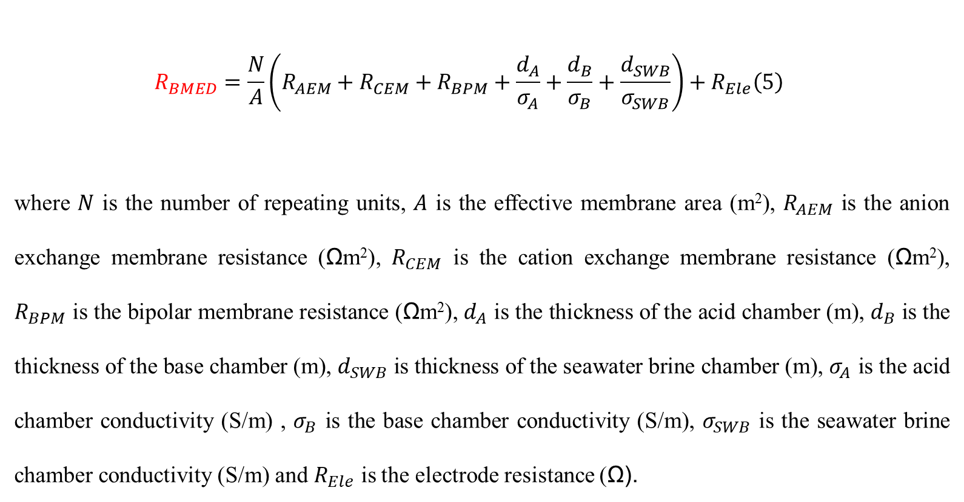
Chapter 1
As constant current is applied, voltage is proportional to the stack resistance. To analyze the reason why voltage remained high, we can explore the stack resistance. The resistance can be expressed:
R_{membrane}
$$\begin{aligned}R_{BMED}=\frac{N}{A}\left(R_{AEM}+R_{CEM}+R_{BPM}+\frac{d_{A}}{σ_{A}}+\frac{d_{B}}{σ_{B}}+\frac{d_{SWB}}{σ_{SWB}}\right)+R_{Ele}\#\left(5\right)\end{aligned}$$
where $N$ is the number of repeating units, $A$ is the effective membrane area (m²), $R_{AEM}$ is the anion exchange membrane resistance (Ωm²), $R_{CEM}$ is the cation exchange membrane resistance (Ωm²), $R_{BPM}$ is the bipolar membrane resistance (Ωm²), $d_{A}$ is the thickness of the acid chamber (m), $d_{B}$ is the thickness of the base chamber (m), $d_{SWB}$ is thickness of the seawater brine chamber (m), $σ_{A}$ is the acid chamber conductivity (S/m) , $σ_{B}$ is the base chamber conductivity (S/m), $σ_{SWB}$ is the seawater brine chamber conductivity (S/m) and $R_{Ele}$ is the electrode resistance (Ω).
R_{chamber}

Slide 2
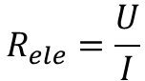
In that case, we can compare the resistance of membrane & chamber when BMED treats NaCl and SWB.
We just need to measure the conductivity of acid/base/SWB chambers and measure the resistance of electrode.
This figure illustrates the voltage change of electrode when current changes.
As the current density used is 15 mA/cm², I=0.106A, U=4.58V, R_{ele}=43.04511Ω
$$R_{ele}=\frac{U}{I}$$
Fig. Voltage drop of the electrode compartments as a function of direct current

Slide 3
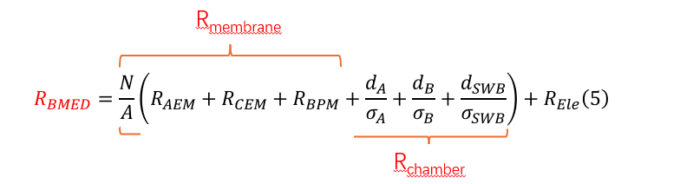
The conductivity of chambers are also measured.
Fig. Conductivity change in the acid, base and SWB chambers

Slide 4
The membrane resistance attributed to the total resistance and total voltage.
SWB
NaCl
Fig. Resistance of membrane and chamber when treating SWB and NaCl

Slide 5
R_{T,1}=R_{mem,1}+R_{cham,1}+Rele
R_{T,2}=R_{mem,2}+R_{cham,2}+Rele
Let R_{cham,1}= R_{cham,2}
Δ R_{T}= Δ R_{mem}
Membrane resistance
Fig. The relationship pf chamber resistance and total resistance

Slide 6
In the experiment, we also find that pH of SWB chamber increased significantly after 30 min.
When treating NaCl, pH of salt solution continued to decrease because the transport speed of proton was fast. This is the normal phenomenon.

Slide 7
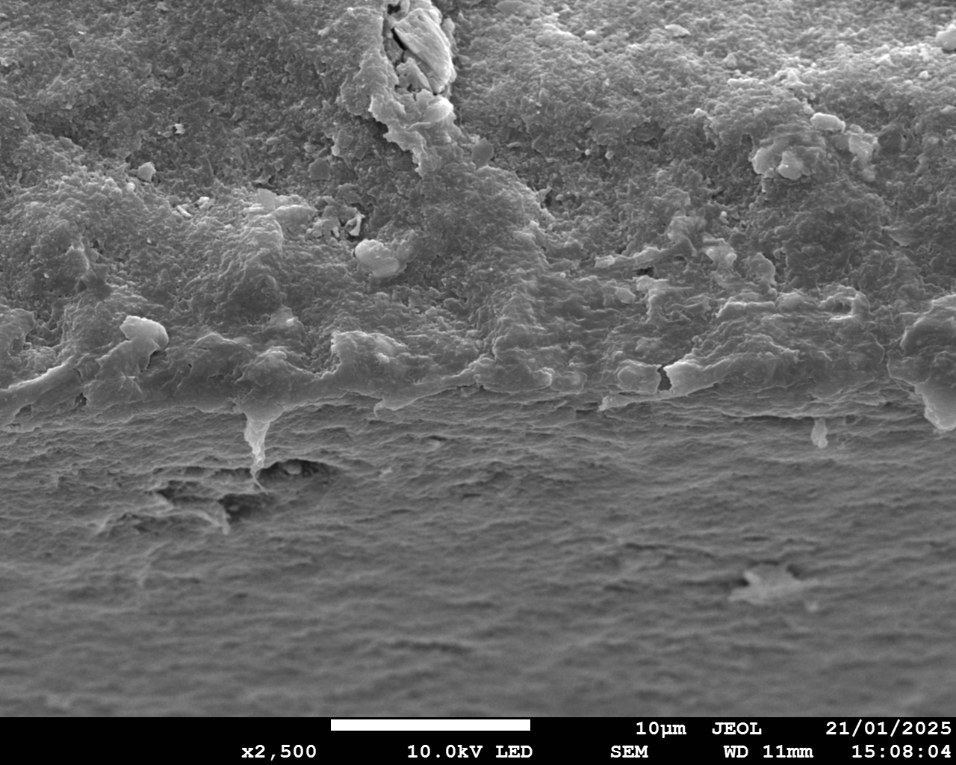
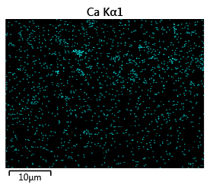
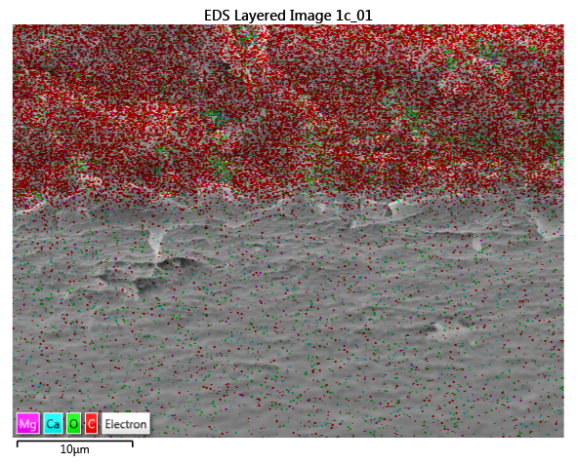
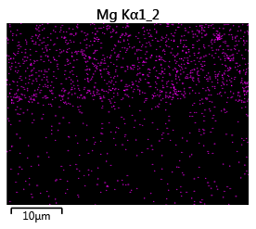
Cross-section of BPM
Cross-section
Surface
10 μm
10 μm
10 μm
10 μm

Slide 8
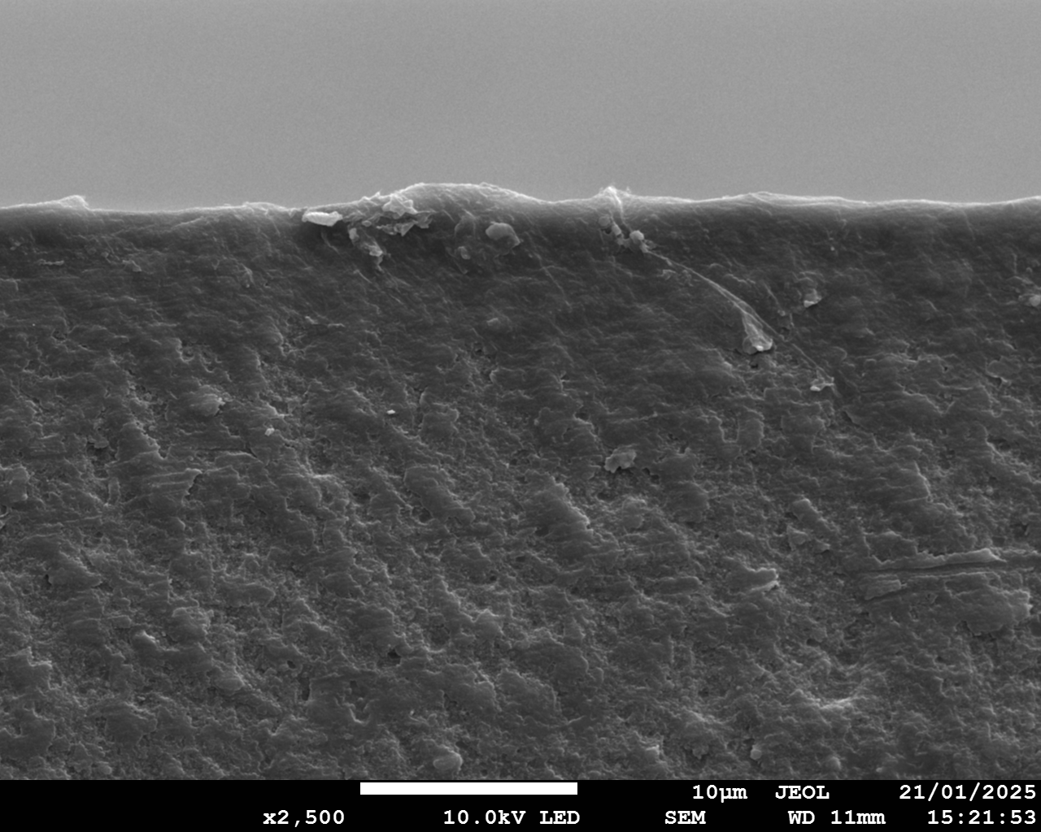
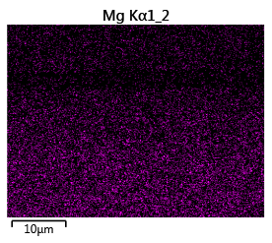
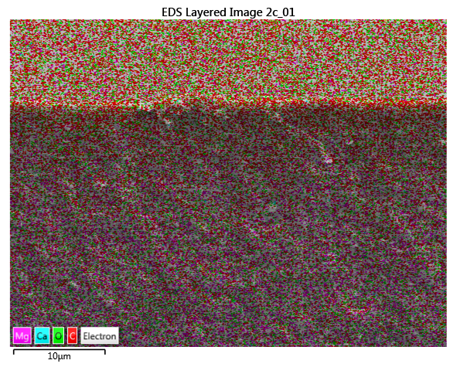
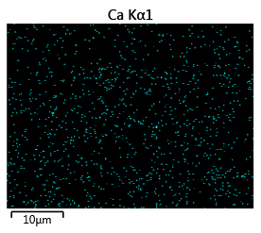
Cross-section of CEM
Surface
Cross-section
10 μm
10 μm
10 μm
10 μm

Slide 9
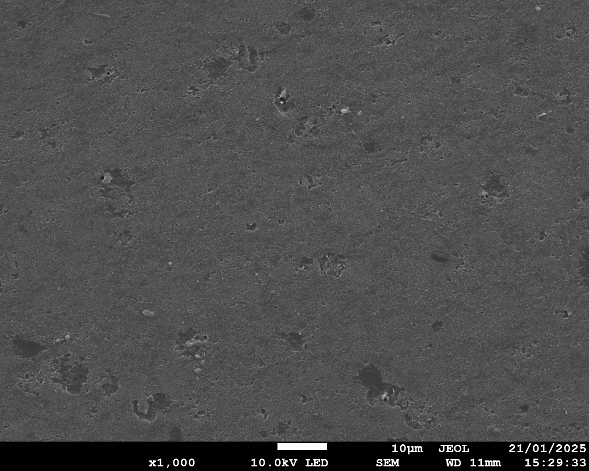
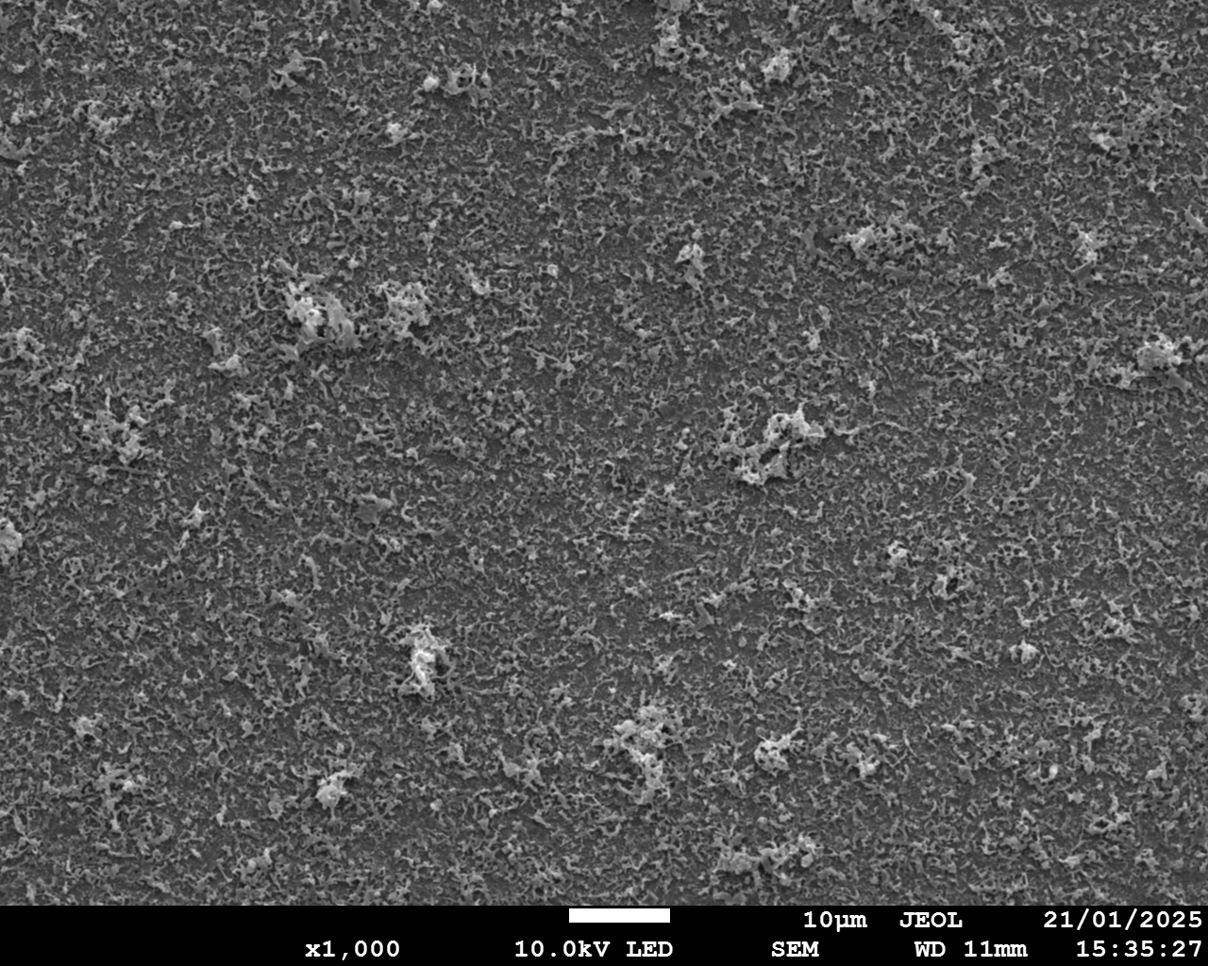
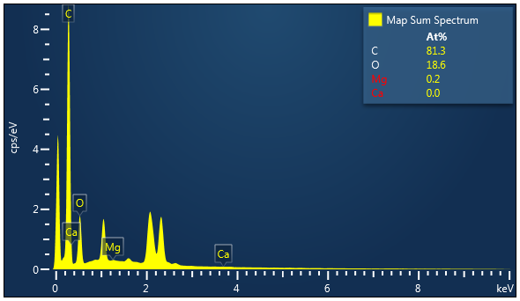
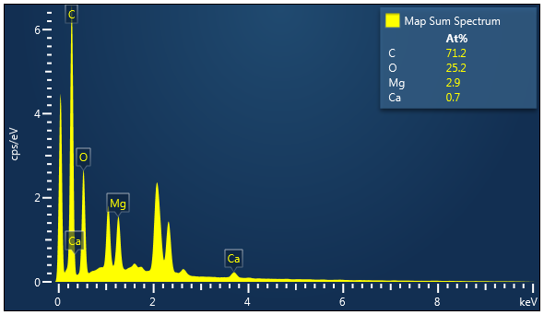
FSWB
Scaling
FB
Chapter 2
0 ppm Mg 10 ppm Ca
10 μm
10 μm

Slide 10
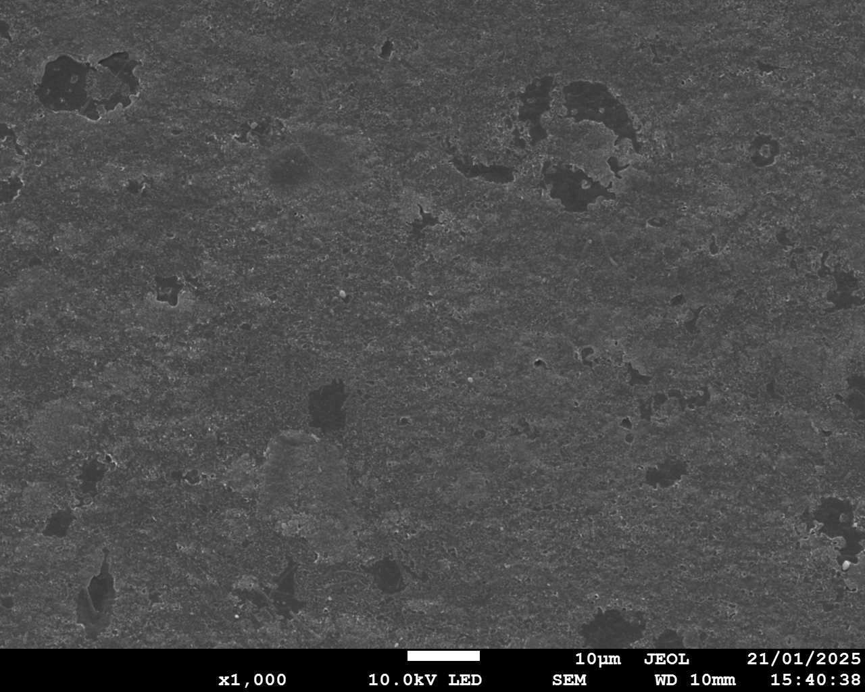
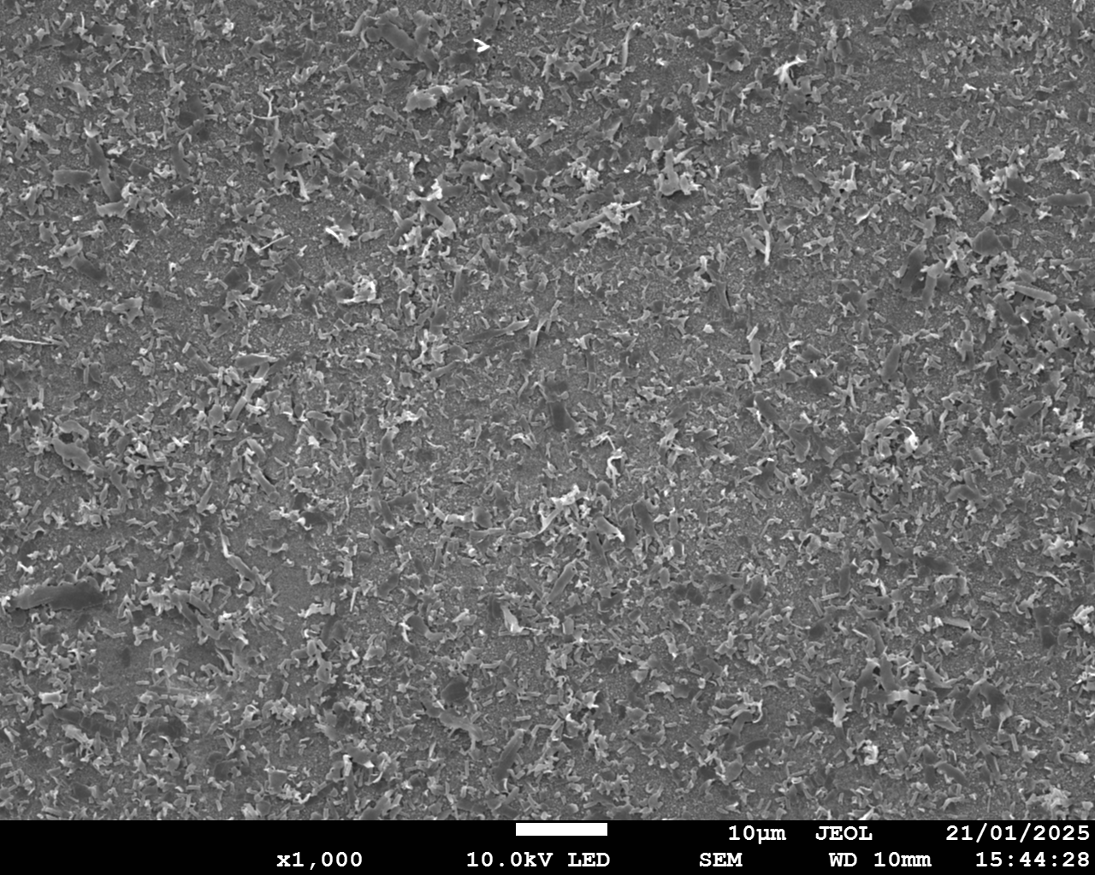
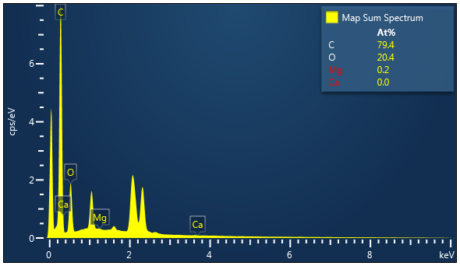
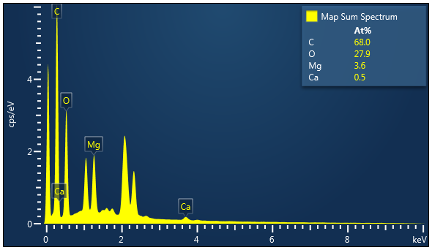
FSWB
Scaling
FB
0 ppm Mg 1 ppm Ca
10 μm
10 μm

